Slide 1

OSGi, a Java framework to deploy modular programs and libraries.
What is it, and why is it cool

Slide 2
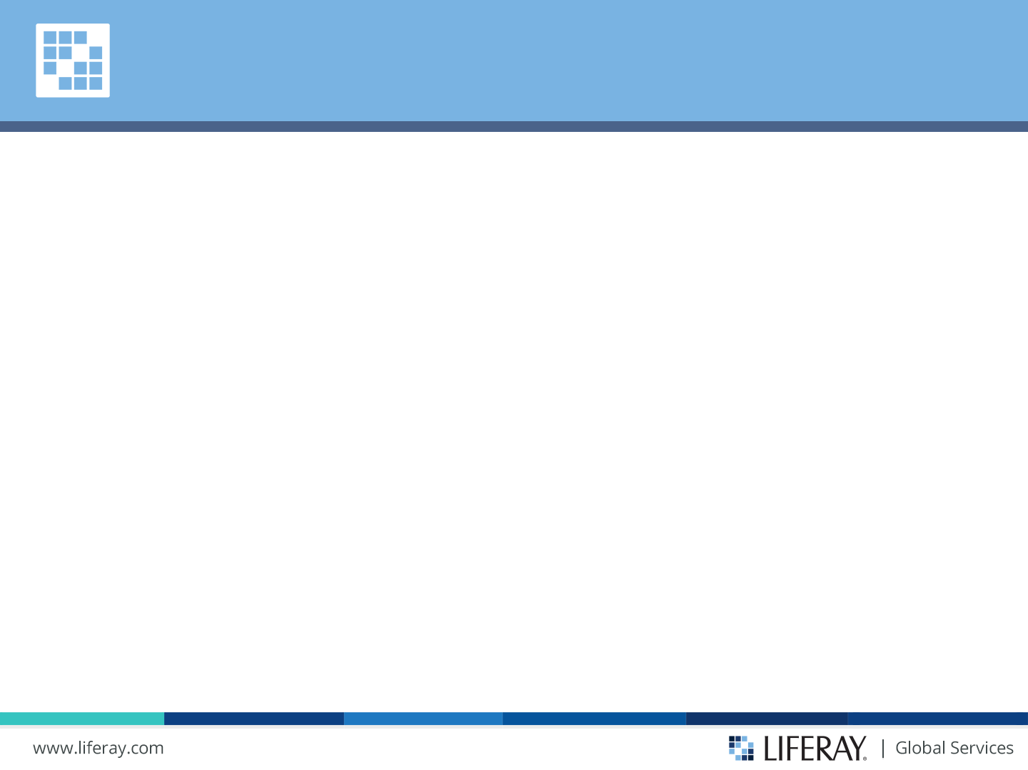
Agenda
-Modularity -What is OSGi -Benefits of Using OSGi -OSGi examples -Example Use Case. How could we benefit using OSGi and Akka together?

Slide 3

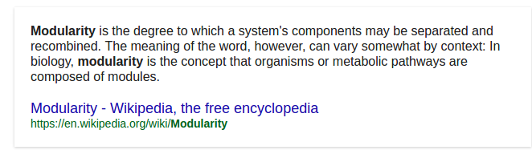

Modularity
Each module contains everything necessary to execute only one aspect of the desired functionality.

Slide 4
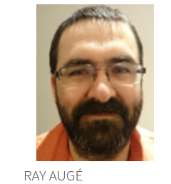
Modularity
Sometimes we have so many features that finding where one feature ends and another begins can be difficult.

Slide 5
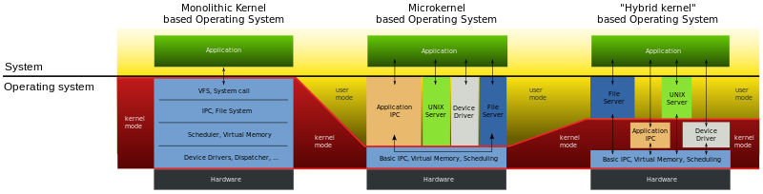
Pros/Cons of Modularity
Disadvantages: Communication/visibility between modules?, dificulty to highly couple interdependant changes in source control systems...
Advantages: Reusability,Replazable components,Distributed Development, Independent Scalability of different components, Security and Access Control...

Slide 6
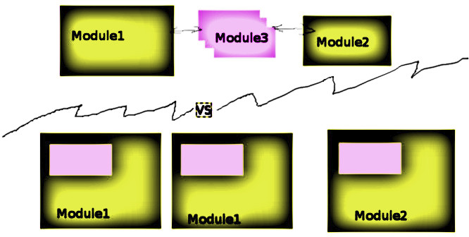
Pros/Cons of Modularity
Advantages: Reusability,Replazable components,Distributed Development, Independent Scalability of different components, Security and Access Control...

Slide 7
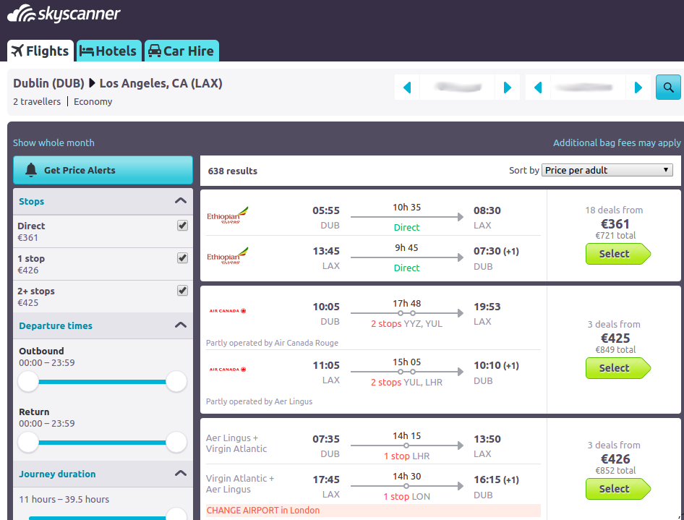
Pros/Cons of Modularity

Slide 8
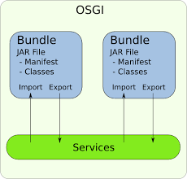

OSGi (Open Services Gateway Iniciative)
Set of specifications that define a dynamic component system for Java.
Hide implementations from other components while communicating through services.

Slide 9
OSGi (Open Services Gateway Iniciative)
To be useful, the bundle needs to...
Export one or more packages ( Export-Package header in the manifest).
Publish one or more services. Services are the way that bundles talk to each other.
Just do something. For that, the bundle needs to have a bundle activator.

Slide 10
OSGi (Open Services Gateway Iniciative)
Mature framework for modular, dynamic, and service-oriented applications

Slide 11
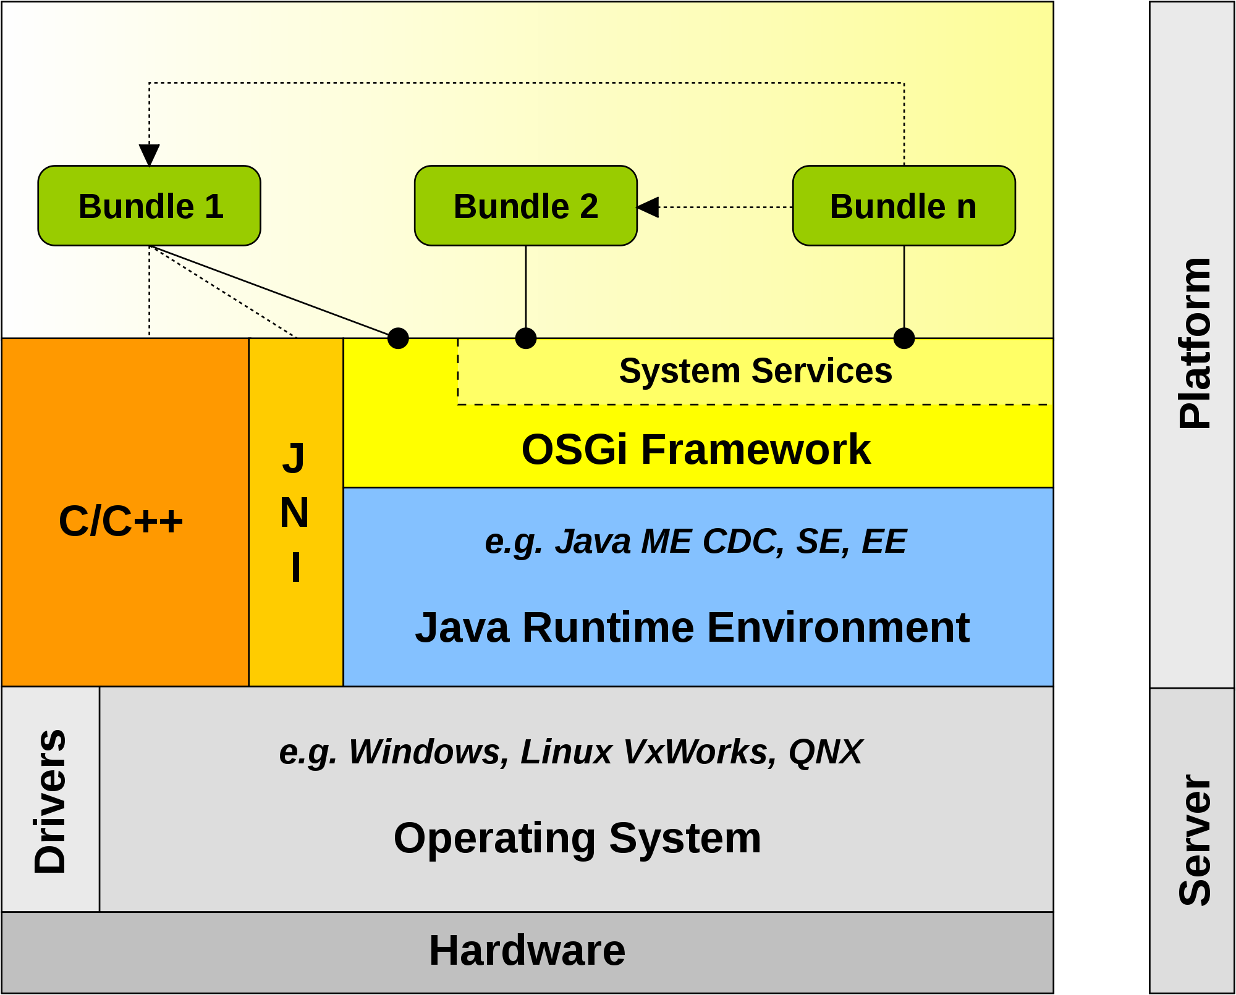
OSGi
Applications are (dynamically) composed of many different (reusable) components

Slide 12
OSGi
Modules (bundles) can be installed, updated, or removed on the fly.
It also has excellent support for modularity and versioning.
We can start module and we can stop module. As for OSGi a module is Bundle or Plugin-in

Slide 13
OSGi
http://paulonjava.blogspot.ie/2014/04/ten-reasons-to-use-osgi.html
Never a ClassNotFoundException
Each bundle in OSGi has it's own class loader.
This class loader can only load classes from the bundle itself, and classes explicitly imported by the bundle using the Import-Package manifest header.
When an imported package is not available (exported by another bundle) in the framework, the bundle will not resolve.

Slide 14
OSGi
It's fast
OSGi has close to zero runtime overhead. Invocations to OSGi services are direct method calls and no proxy magic is required. Remember that OSGi was originally designed to run embedded on small devices; it's extremely lightweight by design. From a deployment perspective it's fast as well. Although there are app-servers with OSGi support, we prefer to deploy our apps as bare bones Apache Felix instances. This way nothing is included that we don't need, which drastically improves startup speed of applications.
Though that a few seconds startup time for an app-server is impressive? That's what an OSGi framework does on a Raspberry Pi ;-)

Slide 15
OSGi
Long term maintainability
This should probably be the key reason to use OSGi; modularity as an architectural principle. Modularity is key to maintainable code; by splitting up a code base in small modules it's much easier to reason about changes to code. This is about the basic principles of separation of concerns and low coupling/high cohesion. These principles can be applied without a modular runtime as well, but it's much easier to make mistakes because the runtime doesn't enforce module boundaries. A modular code base without a modular runtime is much more prone to "code rot", small design flaws that break modularity. Ultimately this leads to unmaintainable code.

Slide 16
OSGi
We never need to restart an application.
I recently blogged about this in more detail in a post "Why OSGi Service dynamics are useful".

Slide 17
OSGi
Versioning
All bundles are versioned and only bundles that can collaborate are wired together in the same class space.

Slide 18
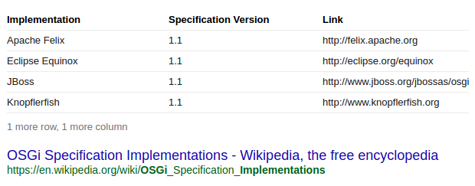
OSGi

Slide 19
OSGi Implementations

Slide 20


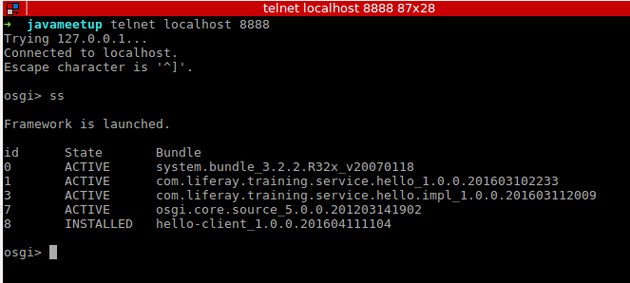
Equinox: Let’s try it
java -jar org.eclipse.osgi_3.2.0.jar -console

Slide 21
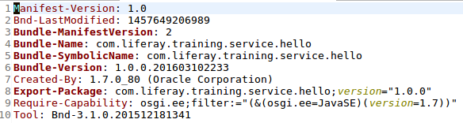
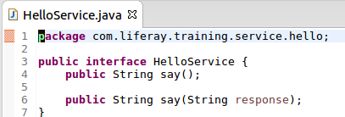
First module: just an interface

Slide 22
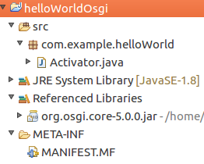
Hello World in OSGi

Slide 23
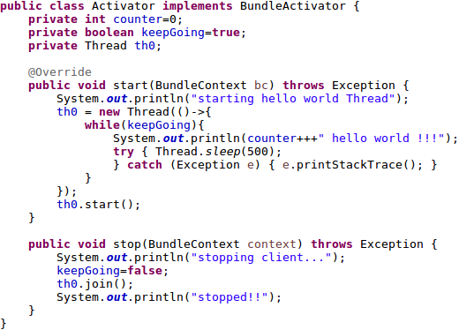
Hello World in OSGi

Slide 24
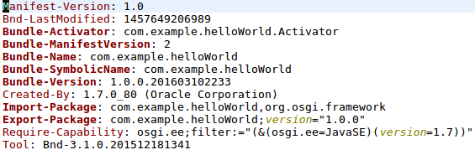
Hello World in OSGi

Slide 25
Hello World in OSGi
Let’s try it!

Slide 26
Hello World in OSGi
THE END
It was not that hard, was it?

Slide 27
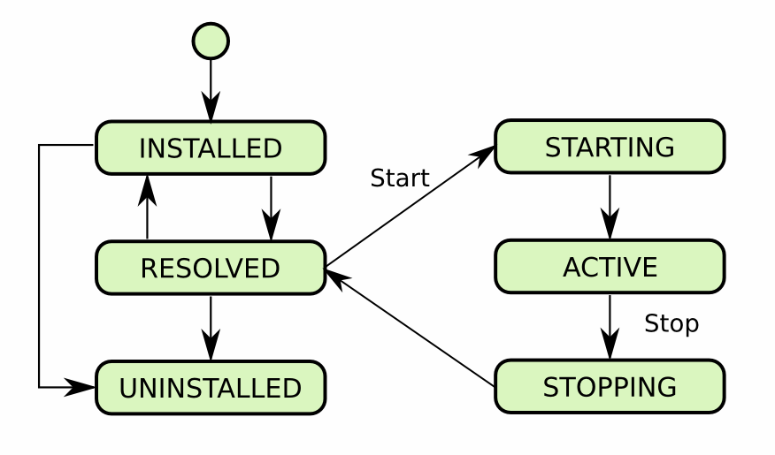
OSGi: Lifecycle of a bundle

Slide 28
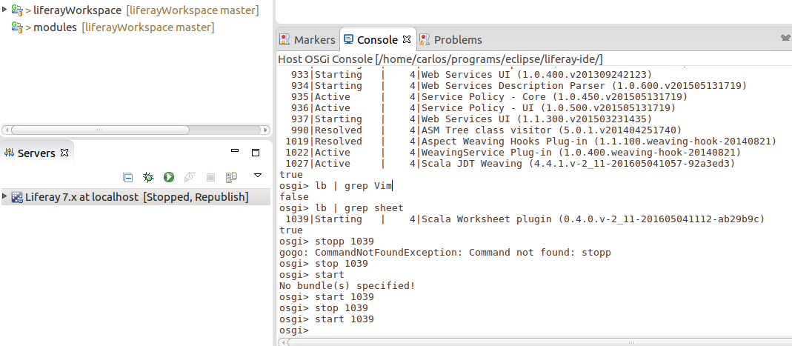
Eclipse IDE uses OSGi too!!

Slide 29
Eclipse IDE uses OSGi too!!
What happens if we stop a bundle in eclipse?

Slide 30
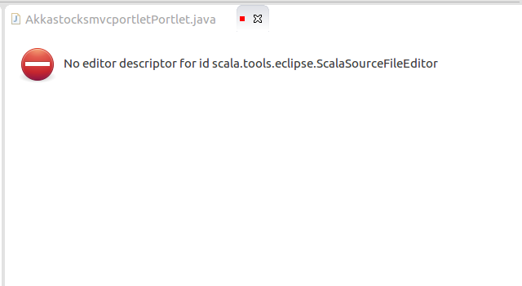
Eclipse IDE uses OSGi too!!
What happens if we stop a bundle in eclipse?

Slide 31
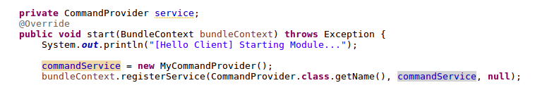
Register a Service in OSGi

Slide 32
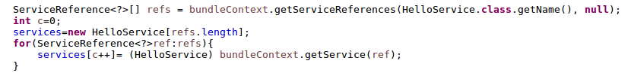
Find a Service in OSGi

Slide 33
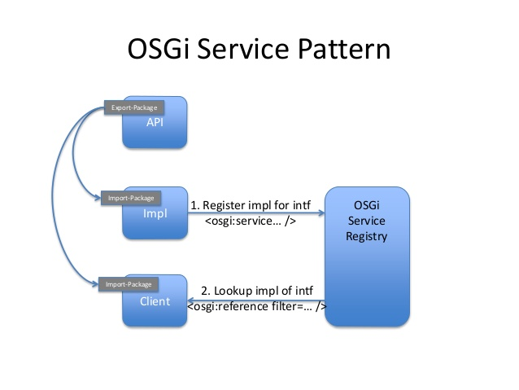
OSGi Service Pattern

Slide 34
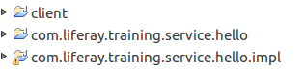
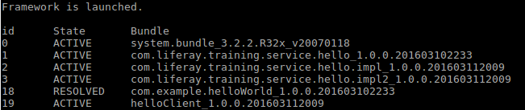
OSGi Modular and DYNAMIC

Slide 35
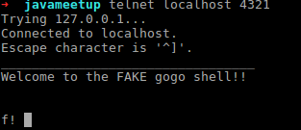
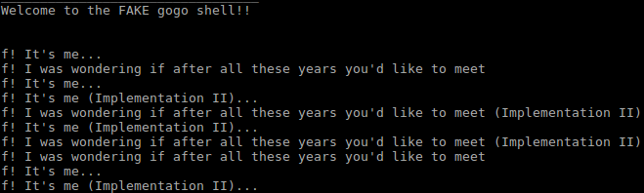
Change service’s implementation
We connect to the client via TCP...
...and we can change different implementations of a service while still running it!!

Slide 36
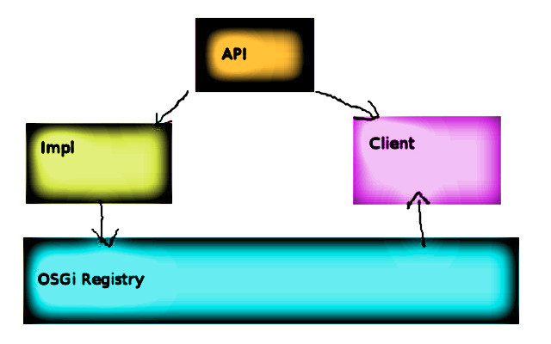
Change service’s implementation

Slide 37
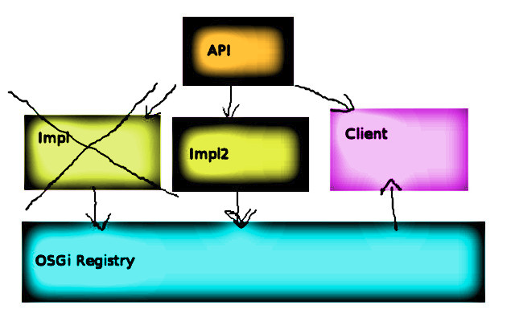
Change service’s implementation

Slide 38
Change service’s implementation
Let’s try it!

Slide 39
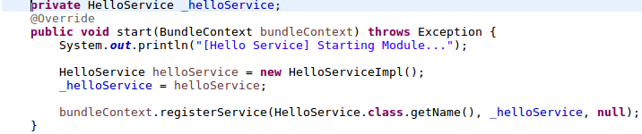
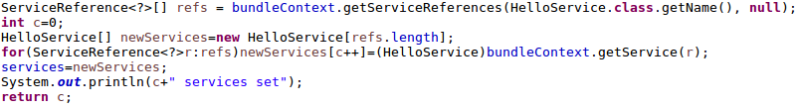
Registering Services
Register the services (Impl)
Get the services (Client)

Slide 40
Registering Services
Services are the way that bundles talk to each other.
A bundle can expose its functionality through one or more services.
This involves for using declarative services, blueprint (or similar) or by creating a bundle activator class that programmatically publishes the service through the OSGi API.

Slide 41
Blueprint
Blueprint. The Blueprint Container specification defines a dependency injection framework for OSGi.
OSGI Compendium.
Open standard based on the Spring Framework.
XML syntax will be familiar to most Java EE developers.
Service injection.
Other features:
Uses Beans (can be constructed by using: a class constructor,a static factory method or an instance factory method).
Activation: Eager or Lazy.
DependsOn attribute (some beans may depend on others).
Scope: Singleton or Prototype.
During initialization, a Blueprint Container registers ServiceFactory-based services for each service manager in the Blueprint Container instead of the actual service objects (Proxies?)
You can use the reference-list element to find multiple matching services (returns either a list of proxy objects or a list of ServiceReference objects)
Reference Manger: A proxy allows the injected object to remain the same while the backing service can come and go or be replaced with another service. Calls on a proxy that does not have a backing service will block until a service becomes available or a timeout occurs.
...

Slide 42
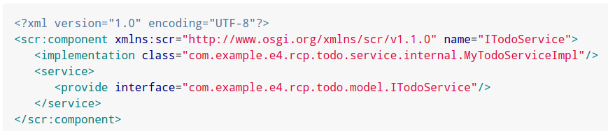
Declarative Services
Declarative Services Specification. Lighter-weight but less feature-rich than Blueprint managed services. Declarative Services specification (part of the OSGi compendium).

Slide 43
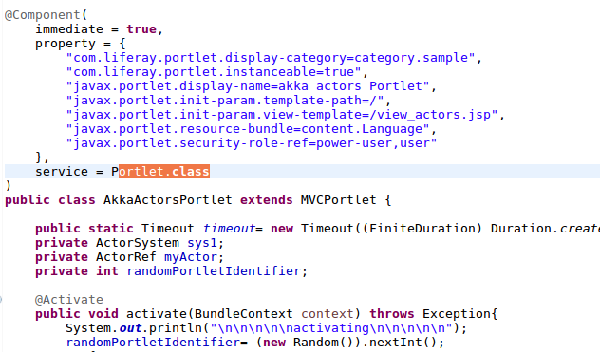
Declarative Services
Declarative Services. Lighter-weight but less feature-rich than Blueprint managed services. Declarative Services specification (part of the OSGi compendium).
Tracking and registering services.

Slide 44
Last example, Akka and OSGi
If it runs on a JVM, it can run on OSGi
(Scala, Groovy, Akka…)

Slide 45
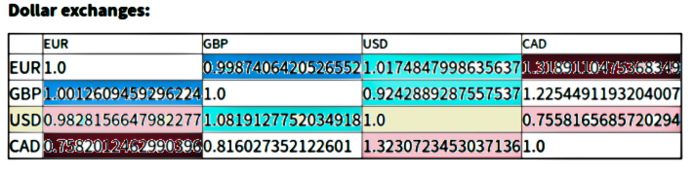
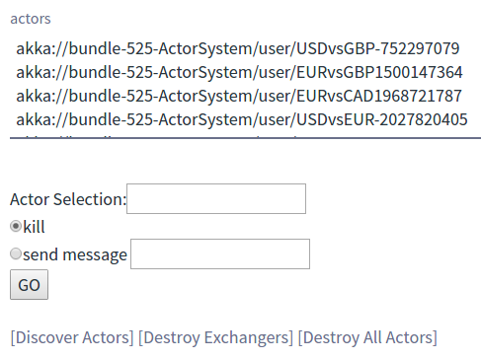
Last example, Akka and OSGi

Slide 46
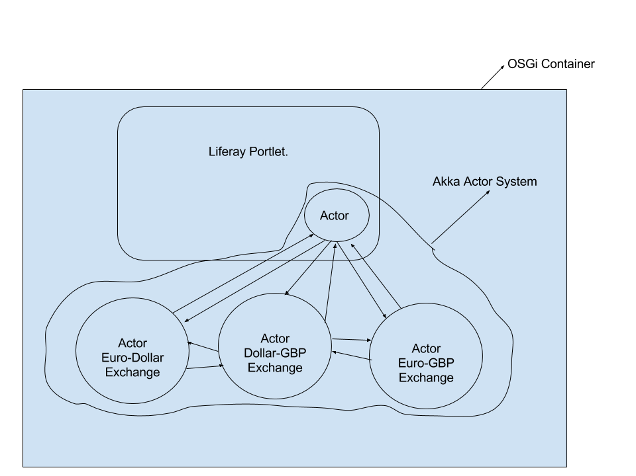
Last example, Akka and OSGi
Basically anything running in a JVM can run in OSGi (Scala, Groovy, Akka…)

Slide 47
Last example, Akka and OSGi
An actor is a container for State, Behavior, a Mailbox, Child Actors and a Supervisor Strategy. All of this is encapsulated behind an Actor Reference. One noteworthy aspect is that actors have an explicit lifecycle, they are not automatically destroyed when no longer referenced; after having created one, it is your responsibility to make sure that it will eventually be terminated as well—which also gives you control over how resources are released When an Actor Terminates.
Why Akka?

Slide 48
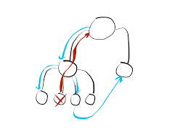
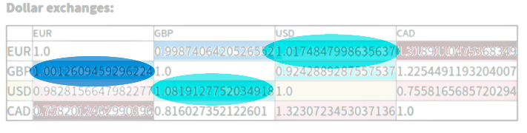
Last example, Akka and OSGi
Why Akka?
Messaging
Supervision Strategies
Asynchrony
Why not?
I like it!
Relates to my last talk
Killing actors is easy

Slide 49

Last example, Akka and OSGi
Why Akka?
Messaging
Supervision Strategies
Asynchrony
Why not?
I like it!
Relates to my last talk
Killing actors is easy

Slide 50
Last example, Akka and OSGi
Why Akka?
Messaging
Supervision Strategies
Asynchrony
Why not?
I like it!
Relates to my last talk
Killing actors is easy

Slide 51
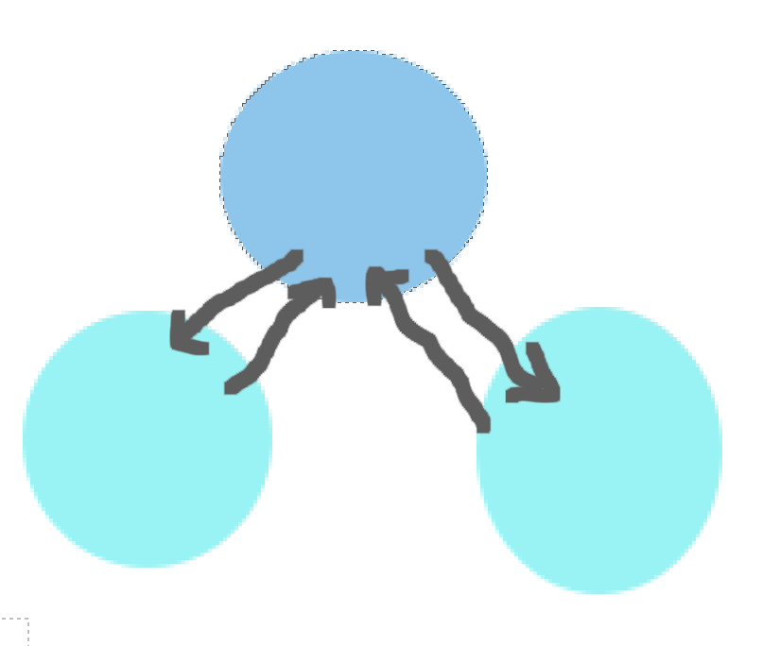
Last example, Akka and OSGi
Why Akka?
Messaging
Supervision Strategies
Asynchrony
Why not?
I like it!
Relates to my last talk
Killing actors is easy

Slide 52
Last example, Akka and OSGi
Warning:
Do not use actors for concurrency, unless…
You need to keep a state.
Example, an actor is created, opens a connection to a database, and from then on, every time it receives a message it can process it without creating a new database connection.
For everything else, use FUTURES:
https://www.chrisstucchio.com/blog/2013/actors_vs_futures.html

Slide 53
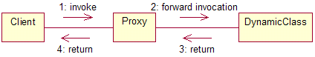
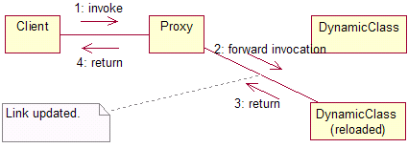
Redeploying a class at runtime
http://www.javaworld.com/article/2071777/design-patterns/add-dynamic-java-code-to-your-application.html

Slide 54
Redeploying a class at runtime
When a class is loaded, the first implementation that matches the requested fully qualified name that is visible to the relevant ClassLoader is what gets returned. Any other implementations with the same fully qualified name are effectively hidden to that ClassLoader.

Slide 55
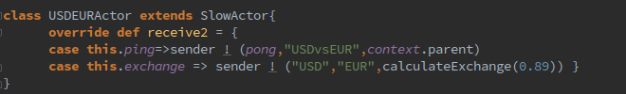
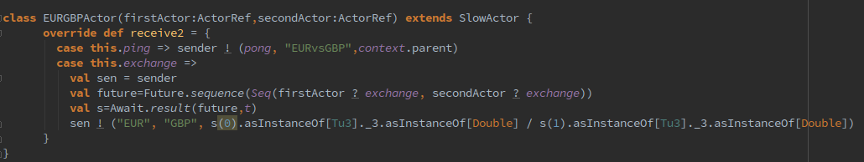
Last example, Akka and OSGi

Slide 56
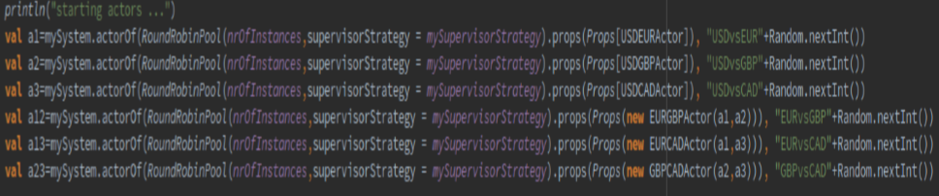
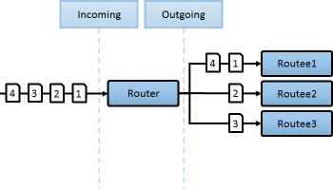
Last example, Akka and OSGi

Slide 57
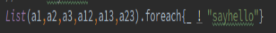
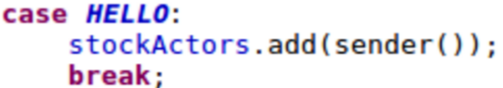
Last example, Akka and OSGi

Slide 58
Last example, Akka and OSGi

Slide 59

Last example, Akka and OSGi
Want a beer?
Let’s see it running first

Slide 60
Who uses OSGi
Eclipse
Liferay
Weblogic
Glassfish
Websphere
JBoss
Jonas
...

Slide 61

Now we have an activity prepared, so I will answer questions later.
I’ll be happy to answer them during any of the breaks (I’ll be around) eating some pizza and chilling out.
Email will work as well: carlos.hernandez@liferay.com

Slide 62
Beer?
Want a beer?

